Slide 1

Beginning the Presentation
To access the interactive features of this training session, please start the file in Presentation mode by clicking here:

Slide 2


Slide 3

How To Save a Consent as a Favorite
Taylor Healthcare Training series

Slide 4

Topics Covered
-Locate a consent
-Save it as a favorite

Slide 5
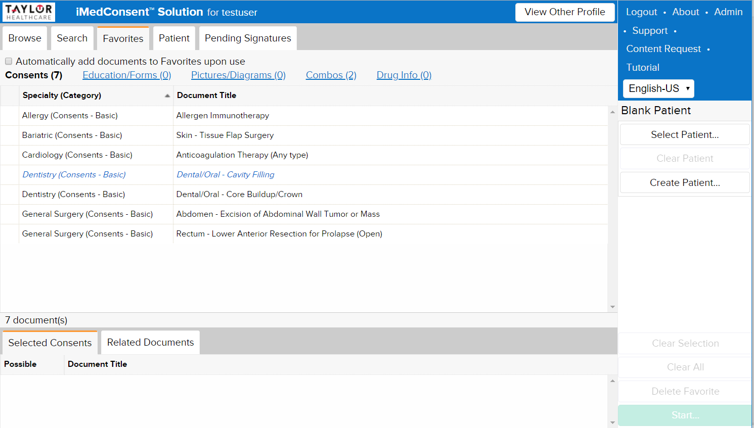
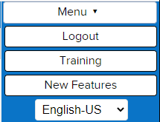

Slide 6
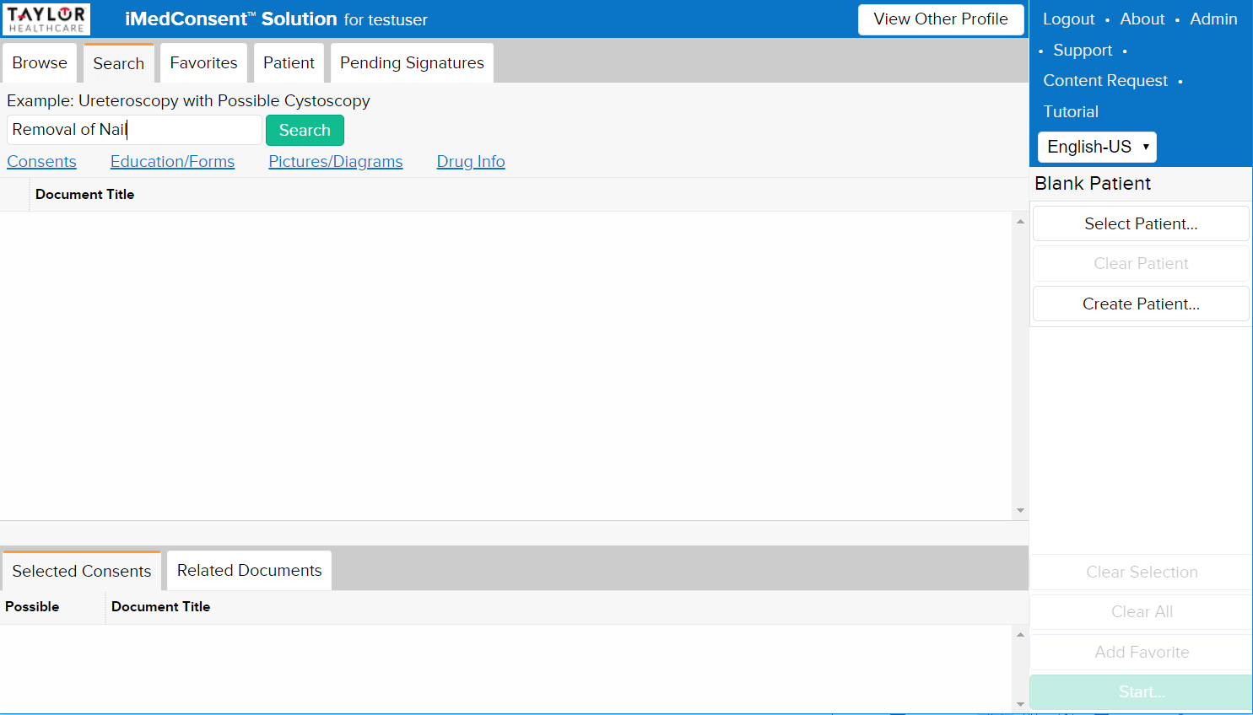

Slide 7
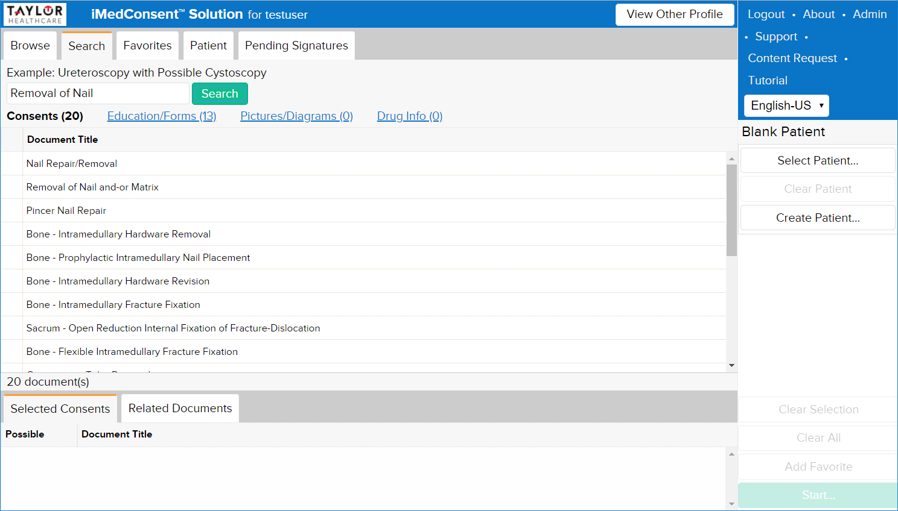

Slide 8
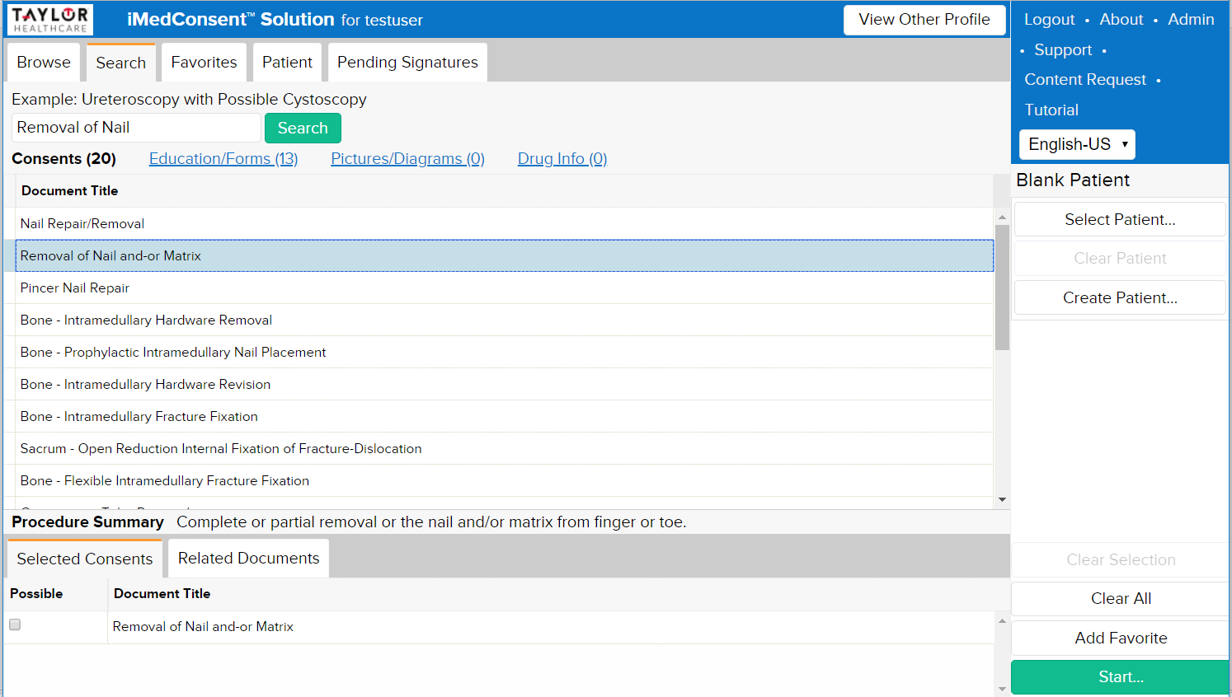

Slide 9


Slide 10
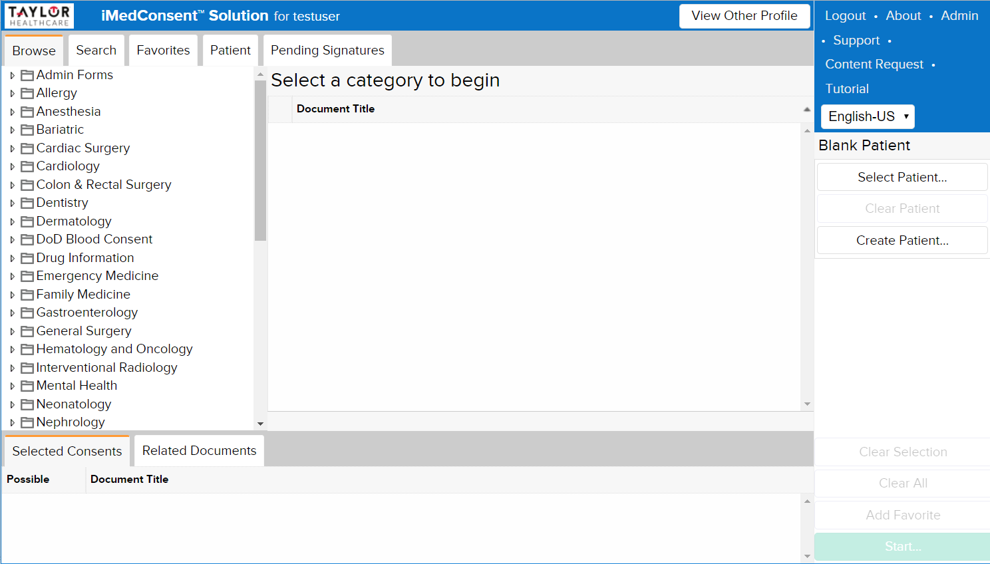

Slide 11
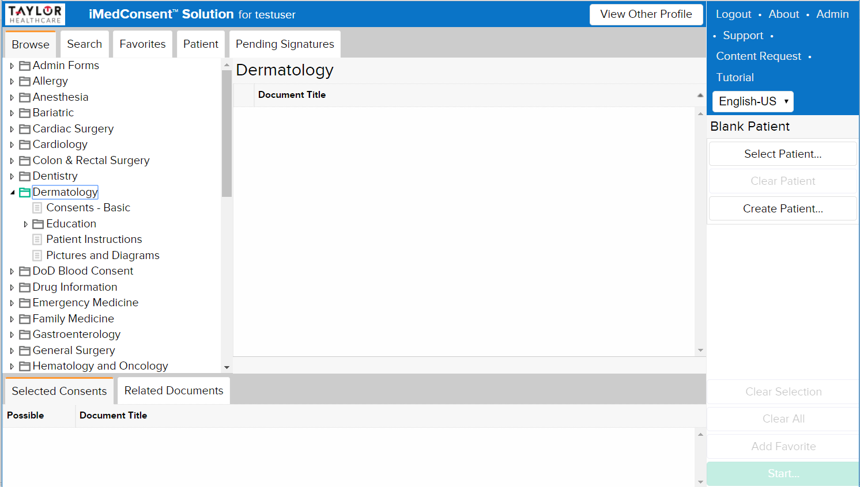

Slide 12
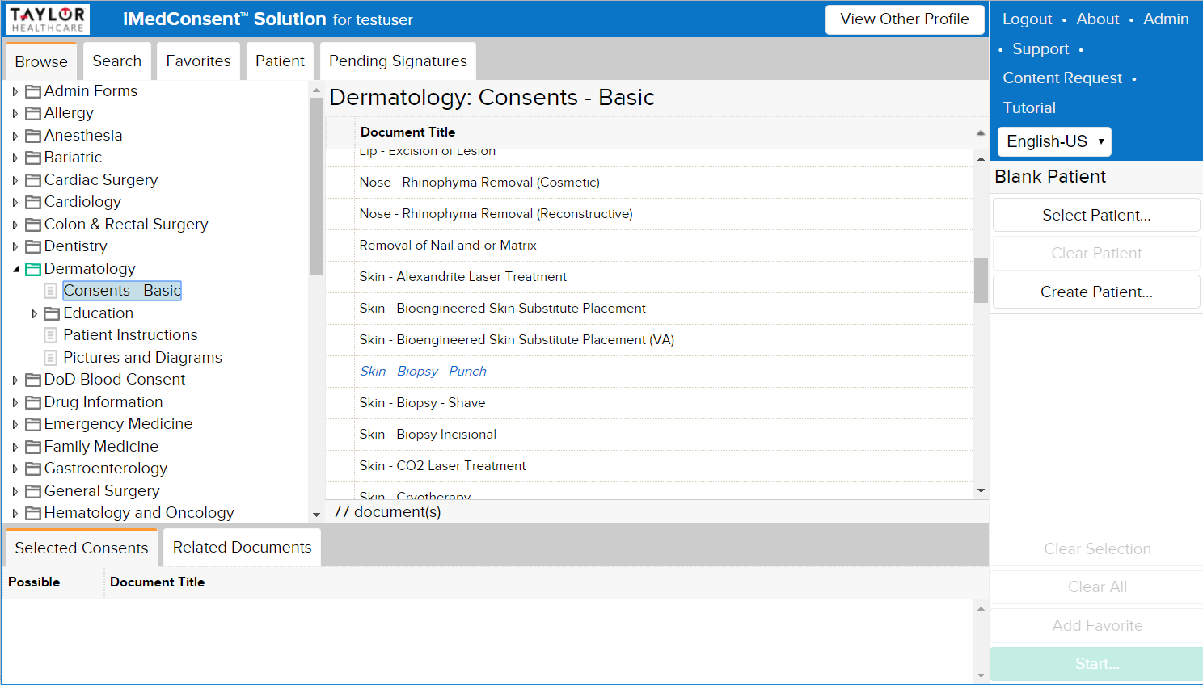

Slide 13
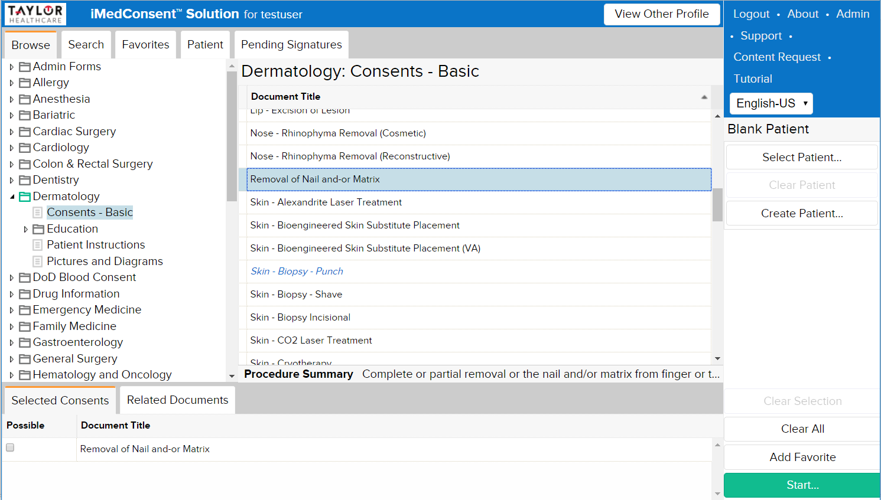

Slide 14
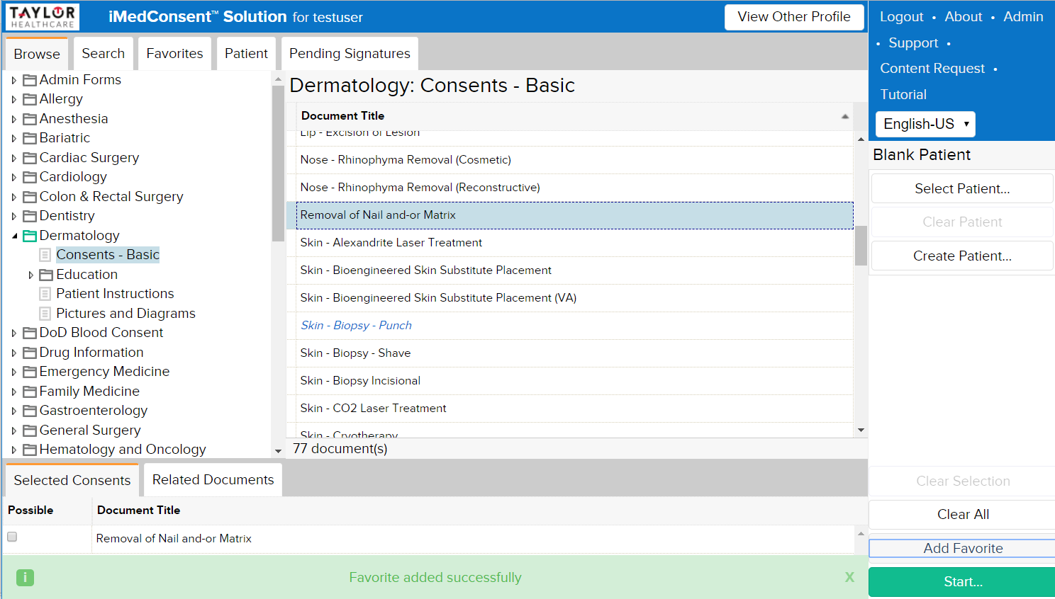

Slide 15
