Slide 1

Beginning the Presentation
To access the interactive features of this training session, please start the file in Presentation mode by clicking here:

Slide 2

Accessing Education Documents
Taylor Healthcare Training series

Slide 3

Topics Covered
-Search for education documents
-Locate by specialty
-Save it as a favorite

Slide 4
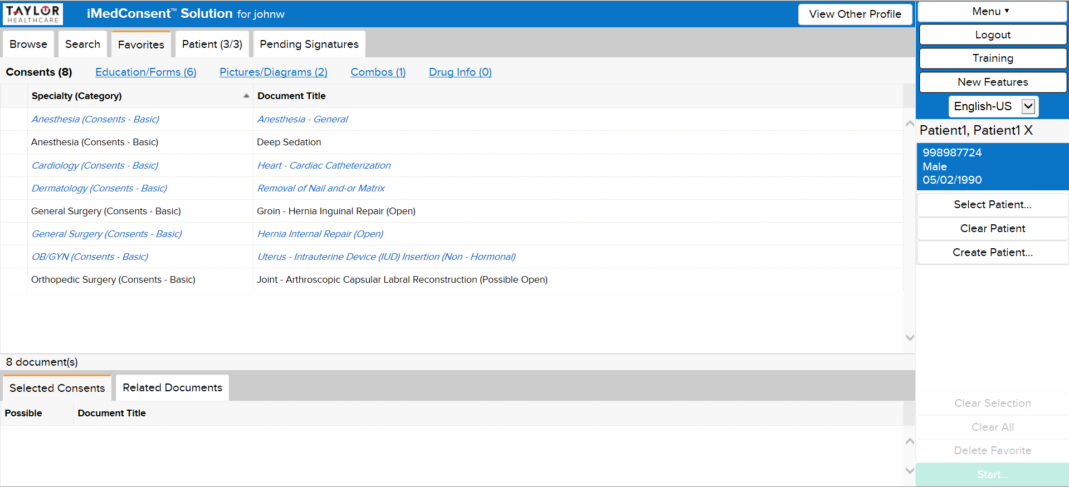

Slide 5
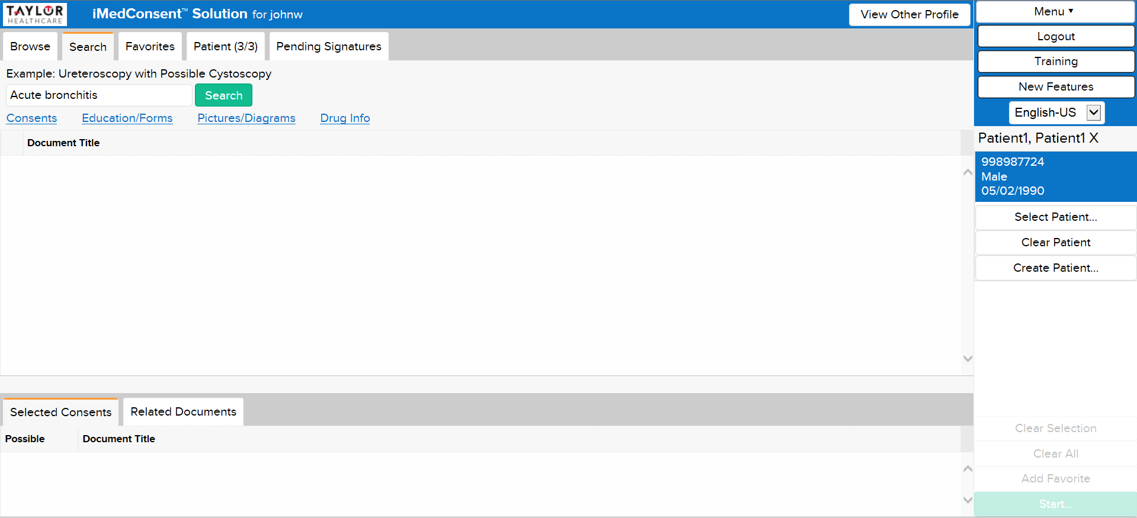

Slide 6


Slide 7
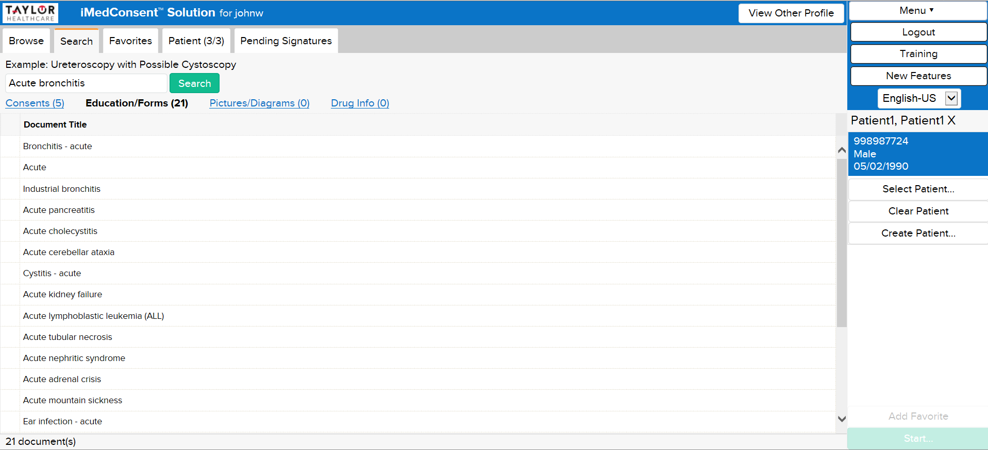

Slide 8
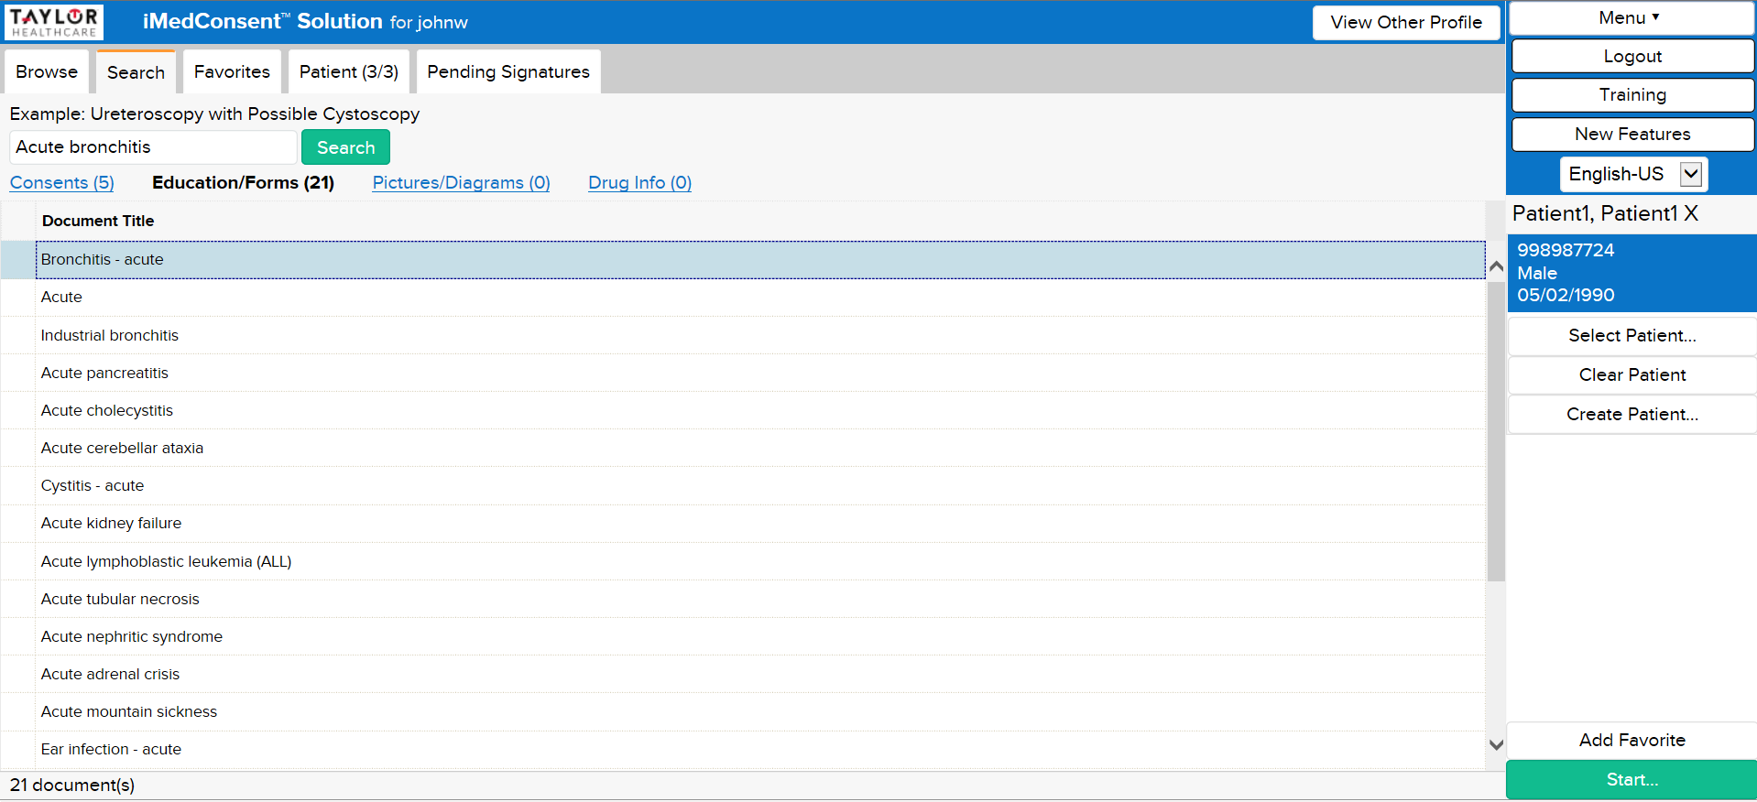

Slide 9
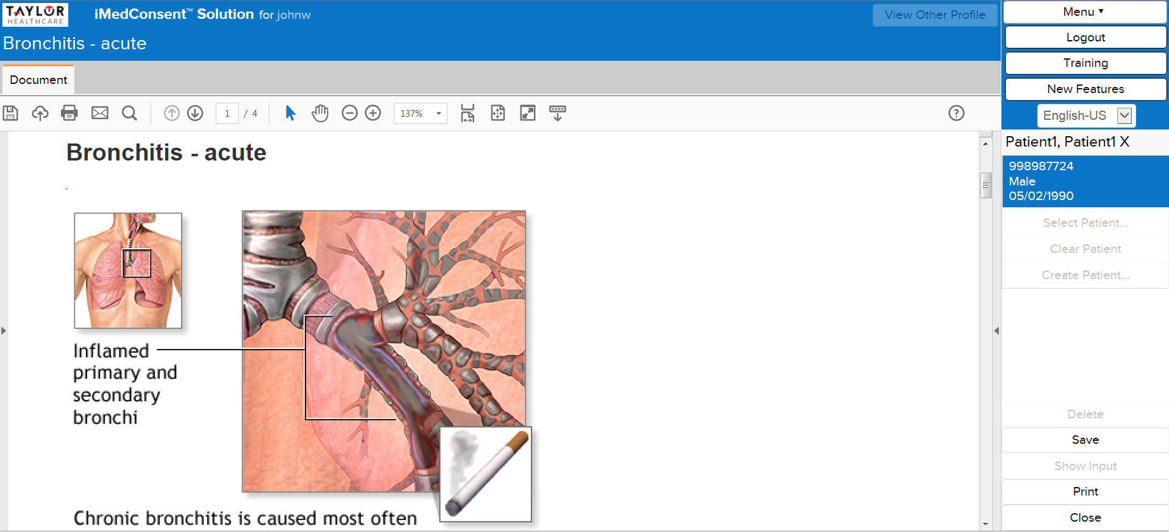

Slide 10


Slide 11
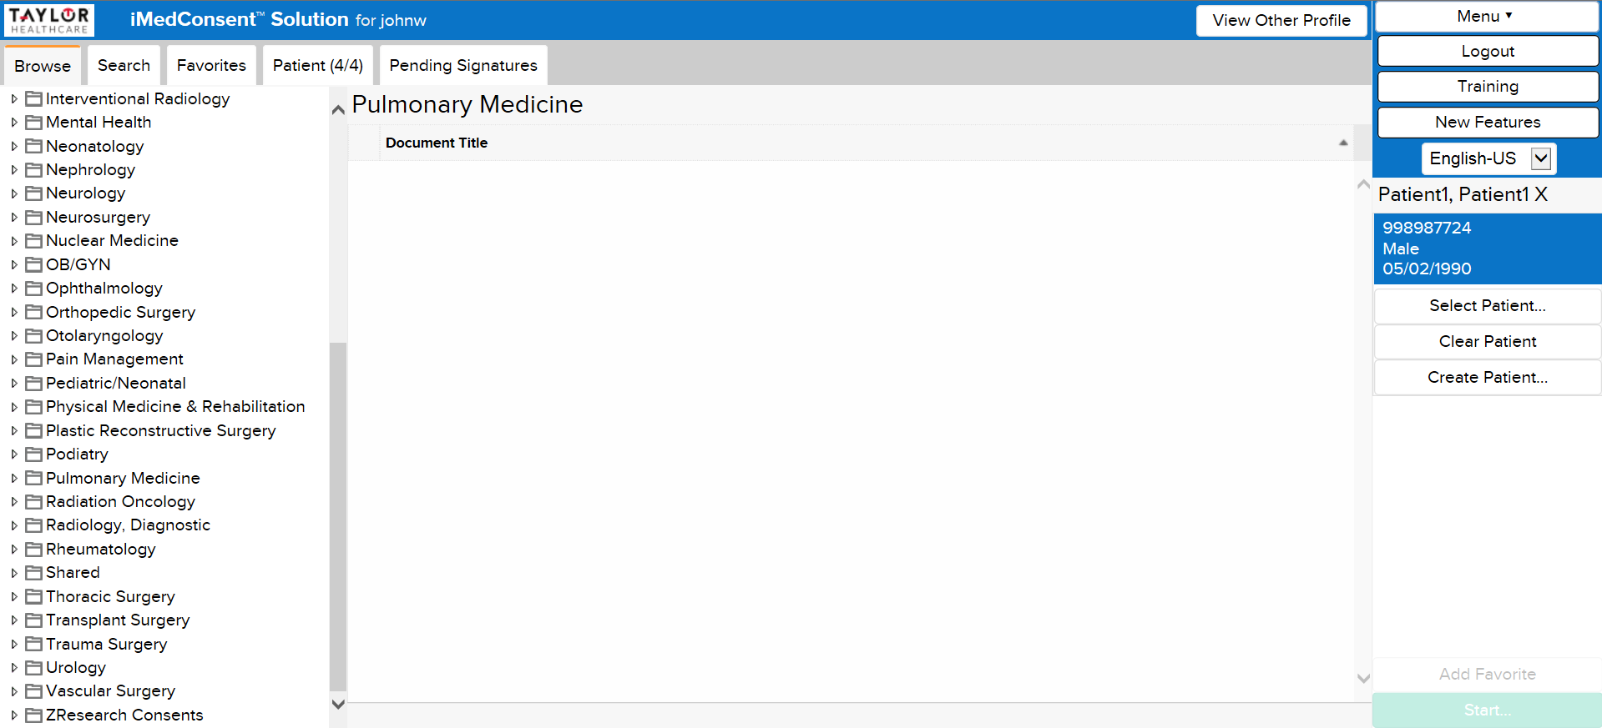

Slide 12
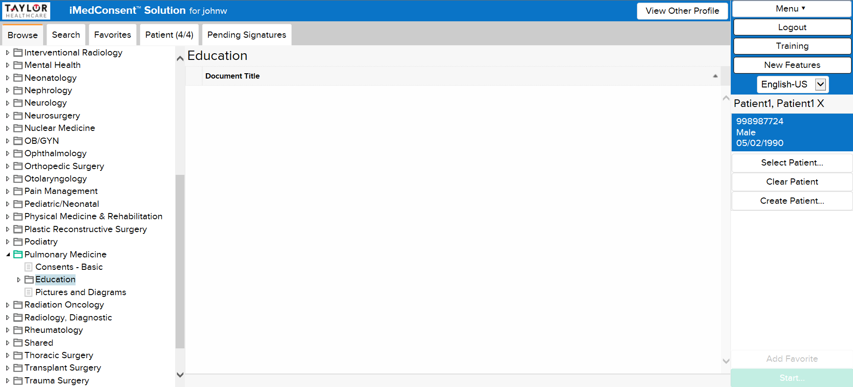

Slide 13
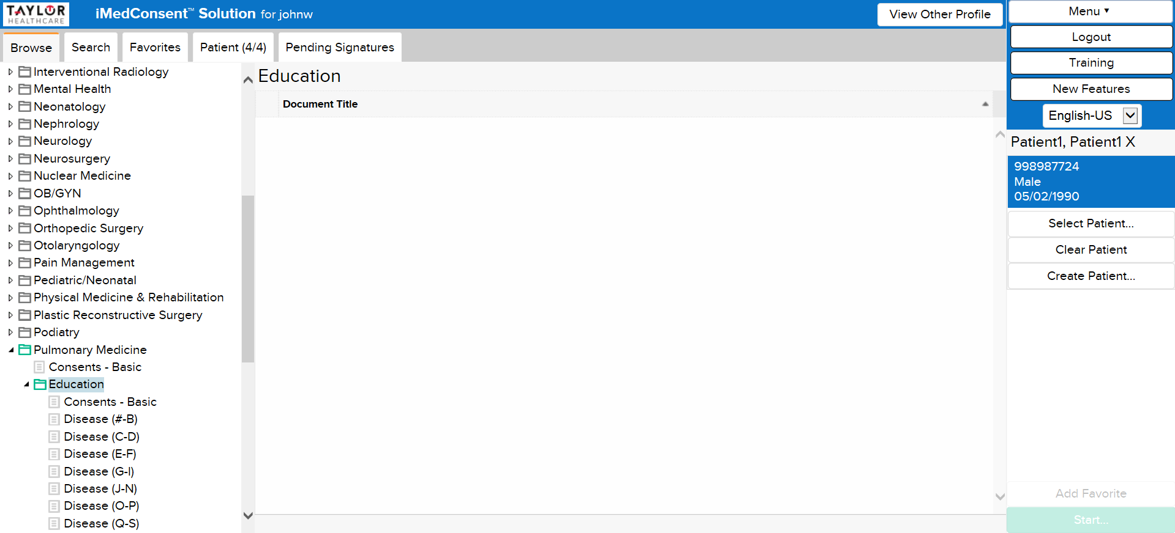

Slide 14
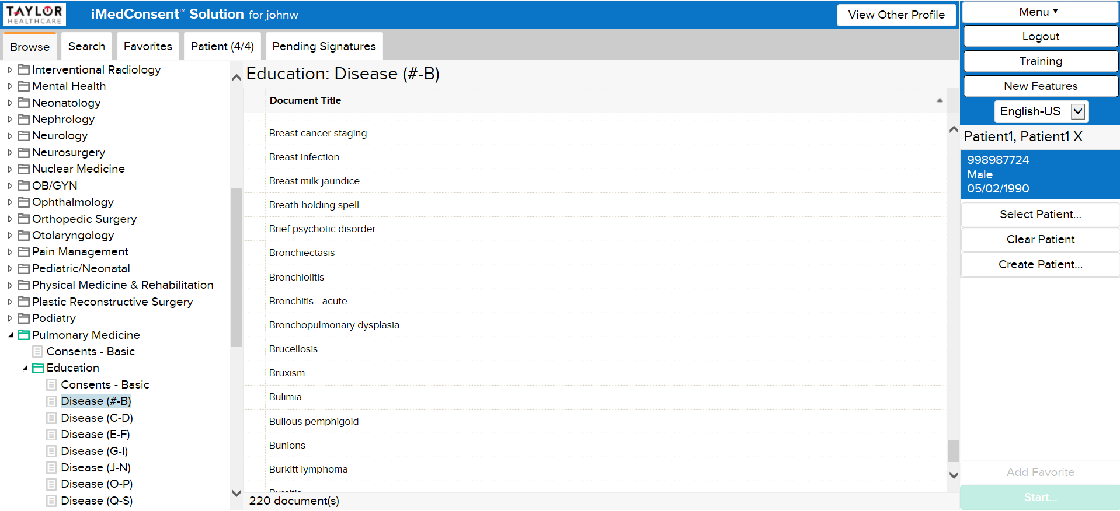

Slide 15
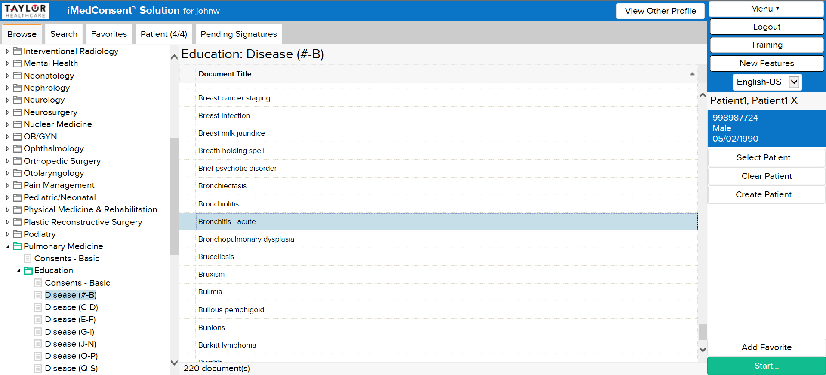

Slide 16
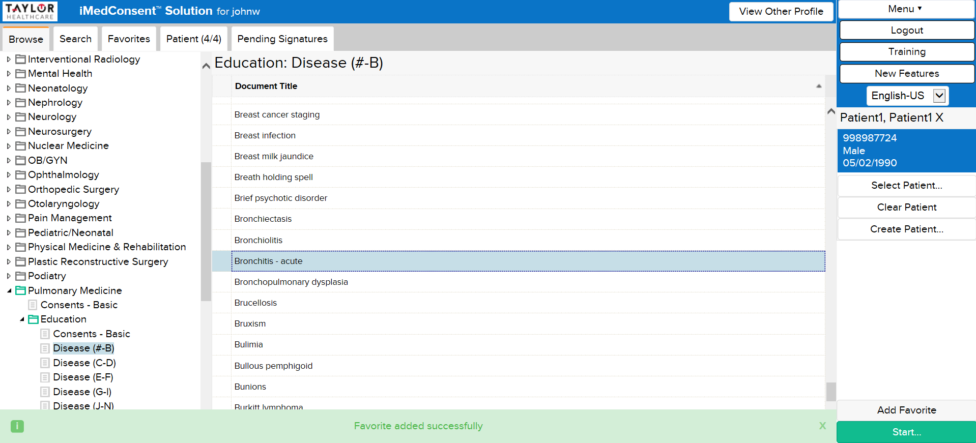

Slide 17


Slide 18
