Slide 1

iMedConsent
End User Training
Version 9.1
July 7, 2017

Slide 2
About
What is iMedConsent?
iMedConsent is a web-based solution that standardizes and automates the informed consent and other patient communication processes.
Trusted by more than 250 hospitals, iMedConsent helps reduce risk, enhance patient safety, ensure accreditation and regulatory compliance, achieve meaningful use requirements, lower cost, and increase patient satisfaction.
The clinical content library includes:
  3,500+ treatments and procedures
  37 specialties
  4,000+ patient education documents
  Pre- and post-procedure instructions
  Anatomical images

Slide 3
Course Outline
Accessing iMedConsent
Navigation
Favorites
Starting the Consent
Customizations
Completing the Consent
Your facility may be configured differently from the examples listed. Some functionality may not be applicable or available at your facility. Consult your facility for specific processes.

Slide 4
Accessing iMedConsent

Slide 5
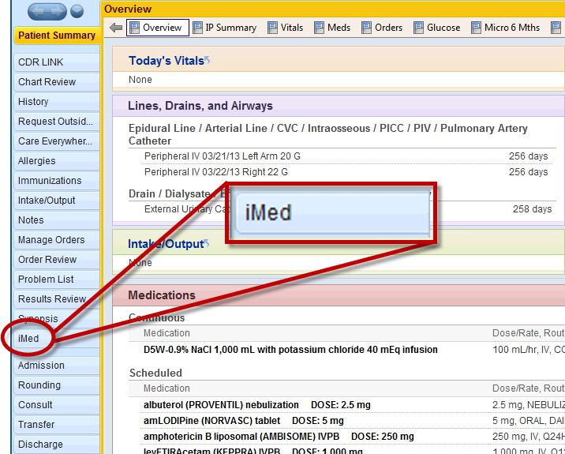
Accessing iMedConsent
Typically, you will access iMedConsent directly through your EMR.
    There may be multiple ways to access iMed. Check with your facility for specific configurations.

Slide 6
Navigation

Slide 7
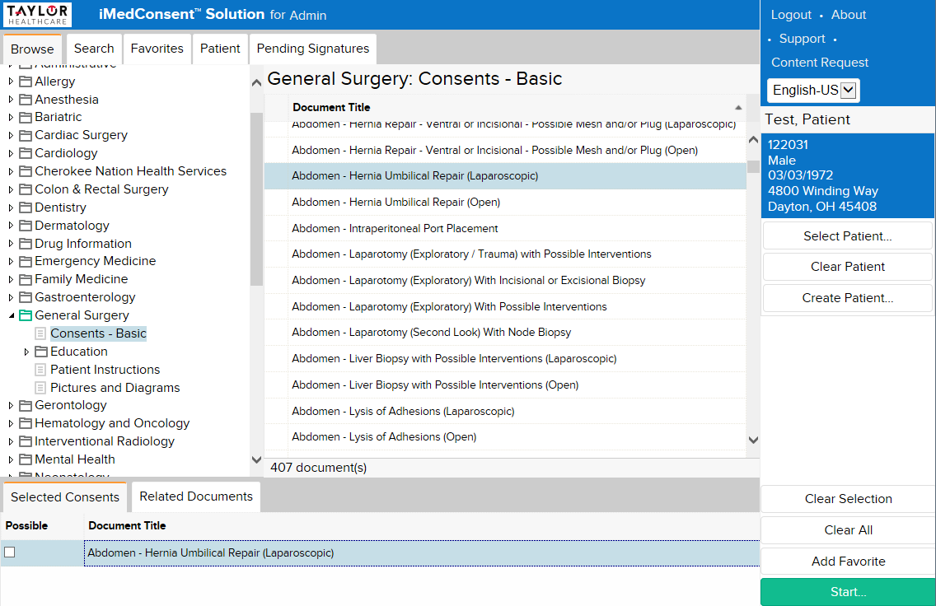
Screen Layout
Pending Signatures tab (if applicable) shows documents that need signatures
Browse/Search/Favorites
To find consents and other library documents.
Patient tab shows documents applicable to the selected patient.
Selected Patient (information from this patient may populate on the final document).
Start to initiate the process.
All procedures listed in the Selected Consents tray will be included in the final document.

Slide 8
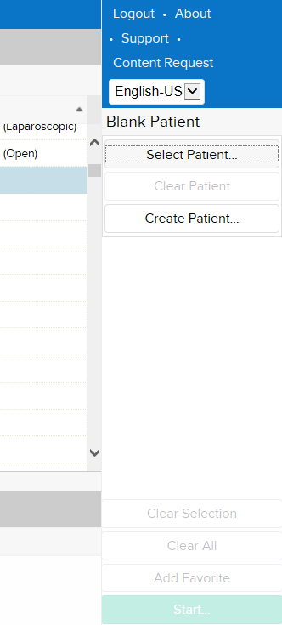
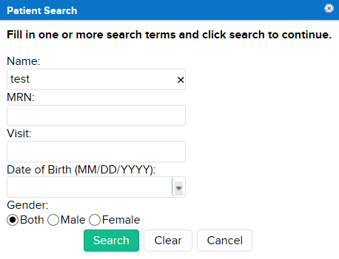
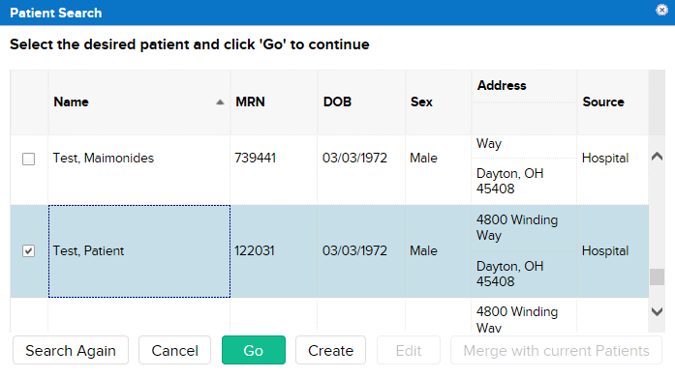
Patient Search
2
Note: This feature is typically used if your facility does not have iMedConsent linked to your EMR.
To manually search for a patient:
Click Select Patient.
Enter your search criteria.
Click Search.
Select the correct patient
Click Go.
1
3
4
5

Slide 9
Browse Consents by Specialty
1
The Browse tab allows you to view the library by specialty (in alphabetical order).
To Browse the library:
Click the Browse tab.
Click on the Specialty, then the Category in the folder tree.
Choose your procedure(s).
Click Start.
3
2
4

Slide 10
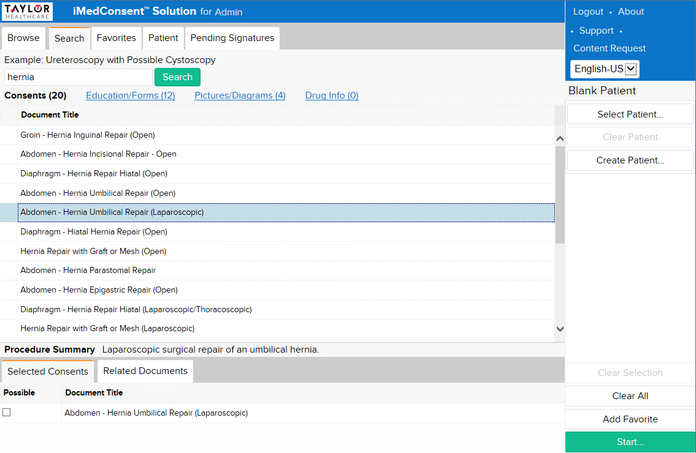
Search by Procedure Name
1
2
The Search tab allows you to search the library by entering key words.
To Search:
Click the Search tab.
Enter your key words in the search field. Use whole words (no wildcards). Click Search.
Choose your procedure(s).
Click Start.
3
4

Slide 11
Favorites

Slide 12

Adding a Favorite
Favorites will allow you to quickly access your frequently used procedures, education forms, and pictures/diagrams.
To add a favorite:
Select a procedure you want to add to your Favorites.
Confirm you have the procedure in the Selected Consents tray,
Click Add Favorite.
A brief pop up message will appear at the bottom of the window.
1
2
3

Slide 13
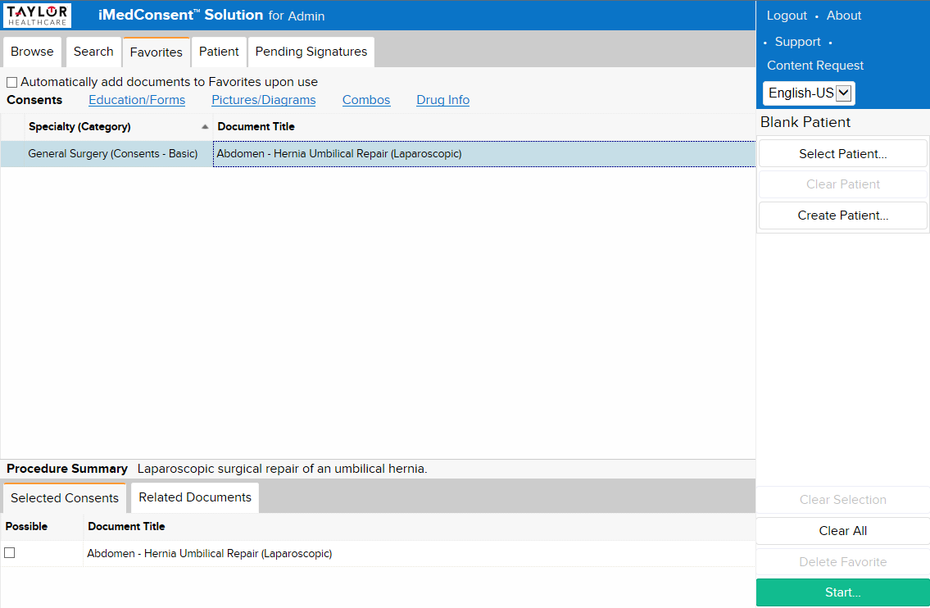
Using a Favorite
1
2
To use a favorite:
Click the Favorites tab.
Select your procedure. The procedure is added to the Selected Consents tray. You can also start by double-clicking the procedure.
Click Start.
Note: You can remove a favorite by selecting it in the Selected Consents tray. Then click Delete Favorite.
3

Slide 14
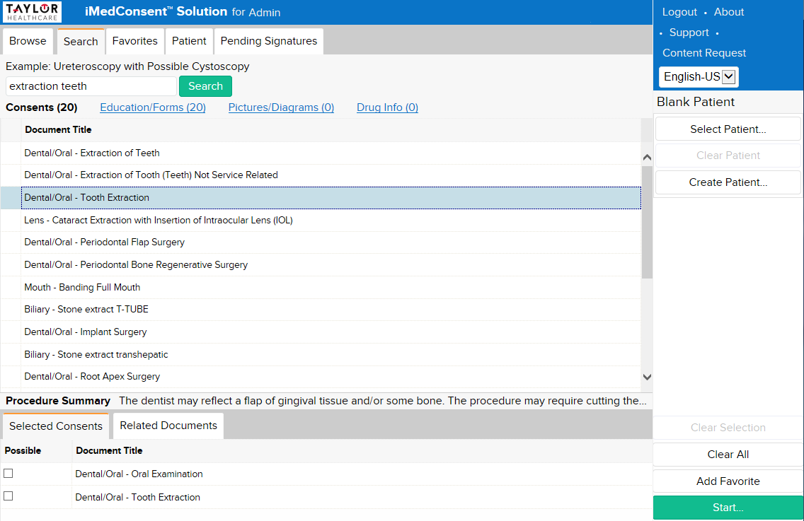
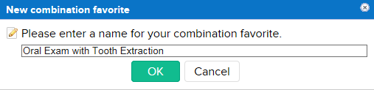
Adding a Favorite Combo
A combination favorite allows you to add multiple procedures to a single consent form in a Favorite link.
Note: You must have more than one procedure selected. To add a combo favorite:
Once you have the procedures in your Selected Consents tray,
Click Add Favorite.
Enter a user specific name for your ‘New combination favorite’.
Click OK.
3
1
2

Slide 15
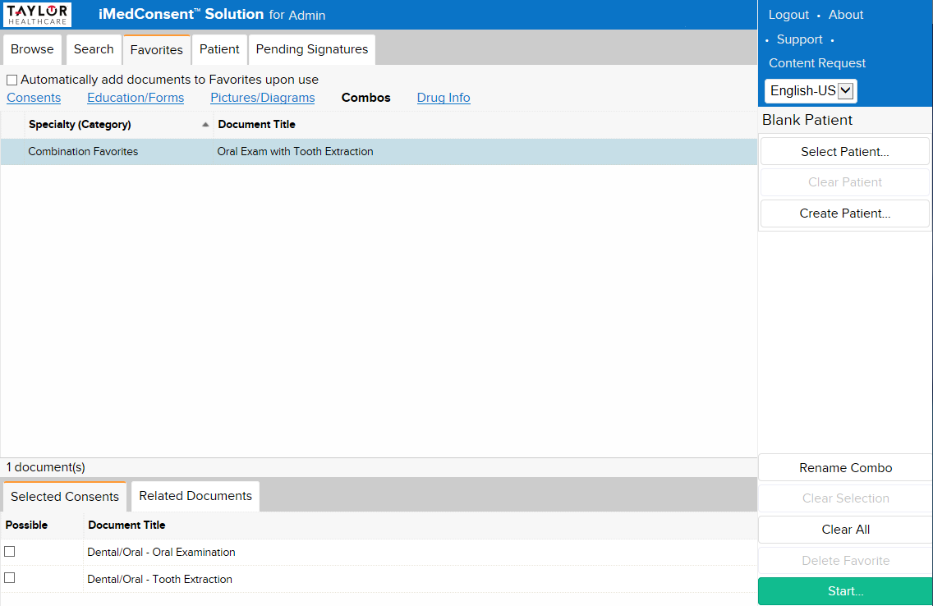
Using a Favorite Combo
1
2
3
The Favorites tab will display your combo procedures under the Combos link.
Click the Favorites tab.
Click the “Combos” link.
Select your favorite combination. Notice all relevant procedures are added to the Selected Consents tray.
Click Start.
Note: You can delete a Combo favorite by selecting a procedure in the Selected Consents tray. Then click Delete Favorite.
4

Slide 16
Starting the Consent

Slide 17
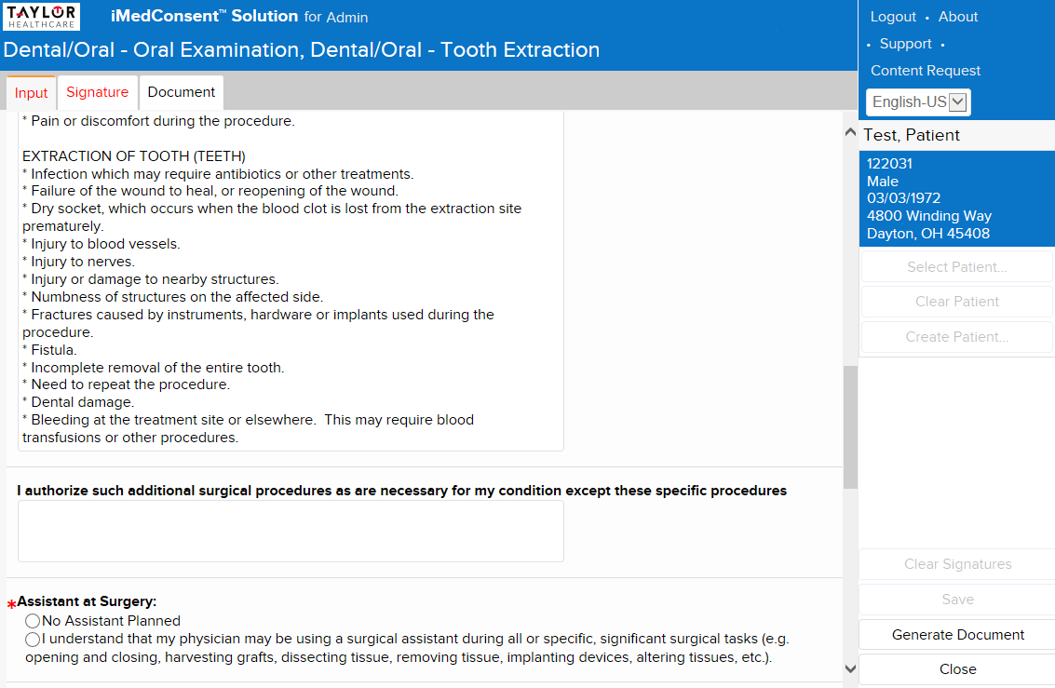
Starting the Consent
Input tab contains questions and options used to compile the final document. Signature tab is used to capture electronic signatures.
Document tab generates the document in its current state.
Save will place this document under the Patient tab.
If all required fields were NOT fulfilled, it will be saved as an incomplete document so you may return later to complete.
If all required fields are fulfilled, it will be saved as a complete document and sent to your imaging server/EMR (if applicable).
Red asterisks (*) are required fields. Once the field is completed, the asterisk will turn black.

Slide 18
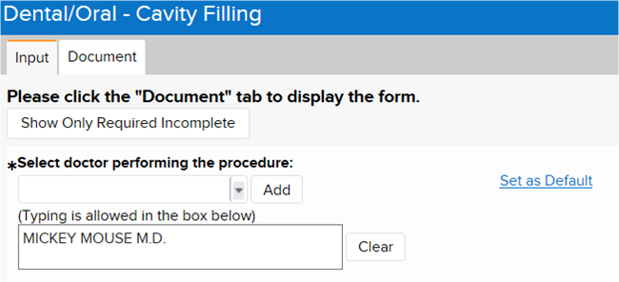
Starting the Consent
Set as Default option is a setting that can be configured to allow users to choose a default value while viewing the Input tab.
Fields that allow saving of default values will display a “Set as Default” link once the value of the field has been changed as shown above.
Once a default list option or text box value is set in this manner, the defaults are retained the next time the document is launched by that iMedConsent user who saved the defaults.
Once a default has been set, the “Set as Default” link will change to “Remove Default”.

Slide 19
Customizing

Slide 20
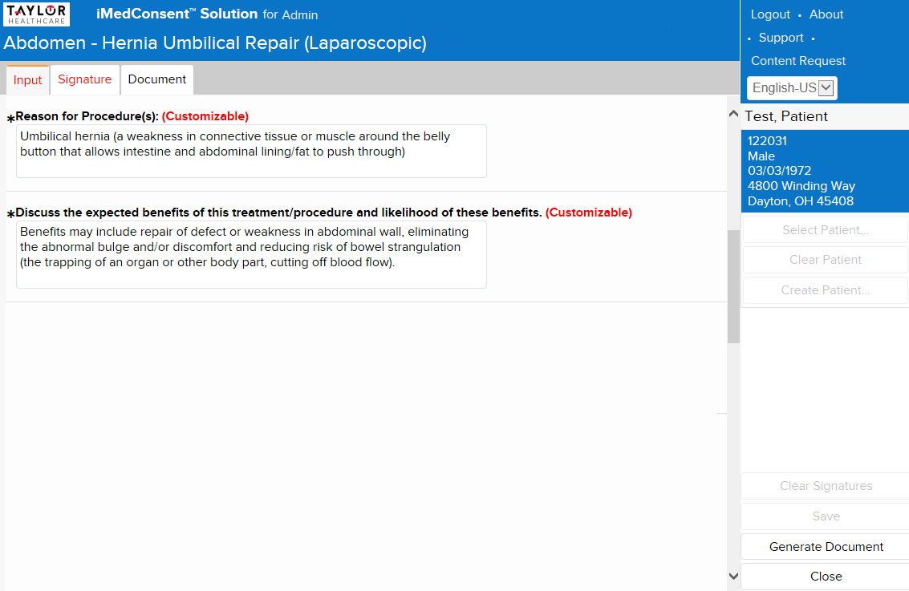

Customizing the Details
Input Tab
As you scroll down, some fields may be indicated with the word (Customizable) in red.
One time edits allow you to make changes on a per document basis.
Customizable allows for free-text additions or edits. You can save these customizations for future use.
Locked fields appear gray and cannot be modified.

Slide 21
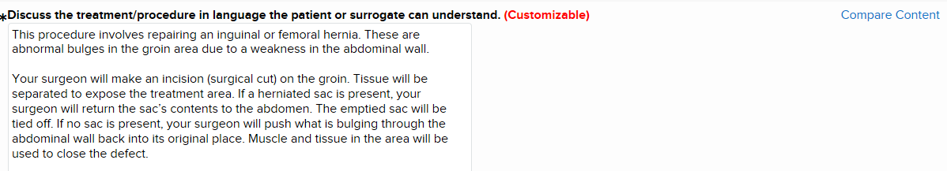
Customizing the Details
  View the original content of a customized field without losing customizations
INPUT TAB:
Users are able to compare the original content and the last saved customization in the same panel allowing the user to compare the two versions of content.

Slide 22
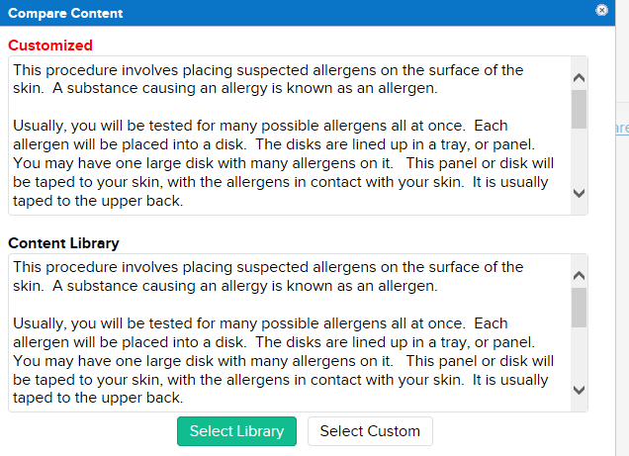
Customizing the Details
When the Compare Content option is selected, iMed brings up a window that allows the user to keep the customizations or change back to the content from the library.

Slide 23
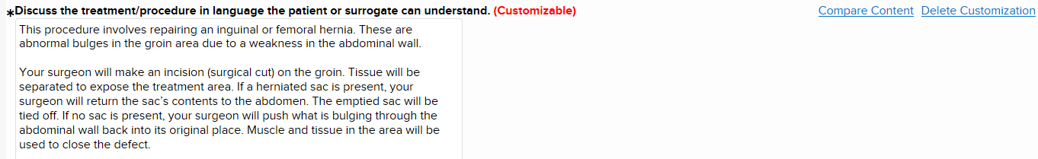
Customizing the Details
  Changes can be removed from the Text Area field from the Input Tab as shown below.
Customizations can be removed from the Text Area field from the Input tab as shown above by selecting Delete Customization.

Slide 24
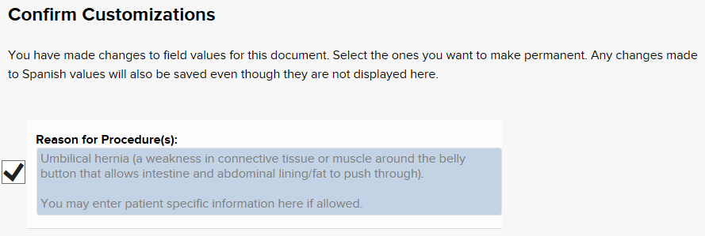
Customizing the Details
If the user missed saving or discarding the customizations from the input tab, the below field will appear once the document is saved or closed. Customizations may be saved or discarded at this time.

Slide 25
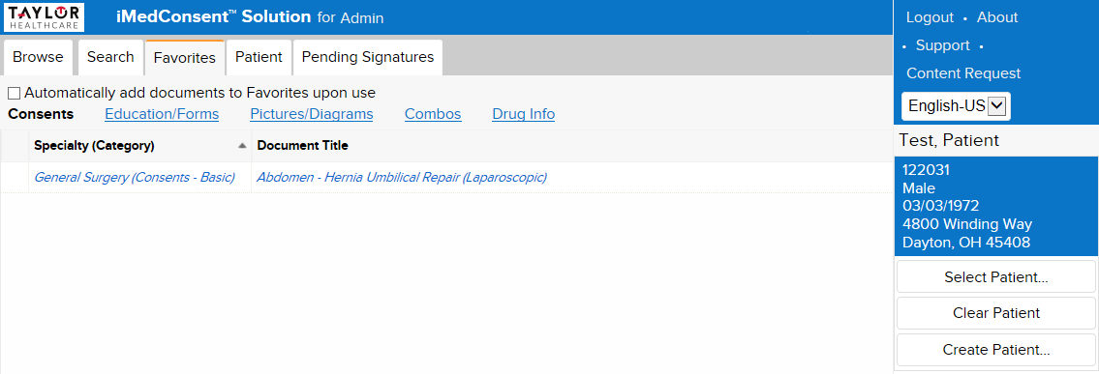
Customizing (continued)
Consents that you have customized will appear in blue italics.

Slide 26
Completing the Consent

Slide 27
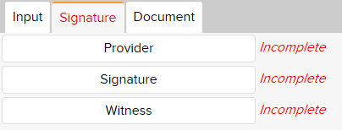
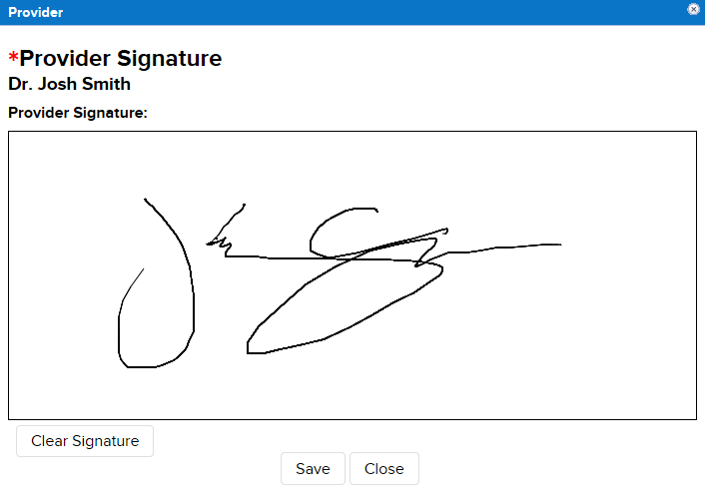
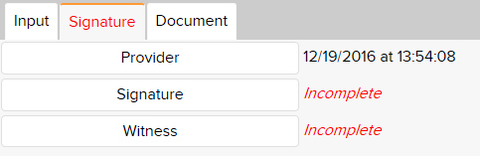
Electronic Signatures
To capture signatures:
On the Signature tab, select the button on which signature you want to capture. A pop-up window will appear.
Sign using the electronic device (e.g. Topaz signature pad).
Click Save.
Click Close.
Note: Your facility must have a compatible signature device.
1
A date and timestamp will display next to the signature button of the signed and saved signature.
3
4

Slide 28
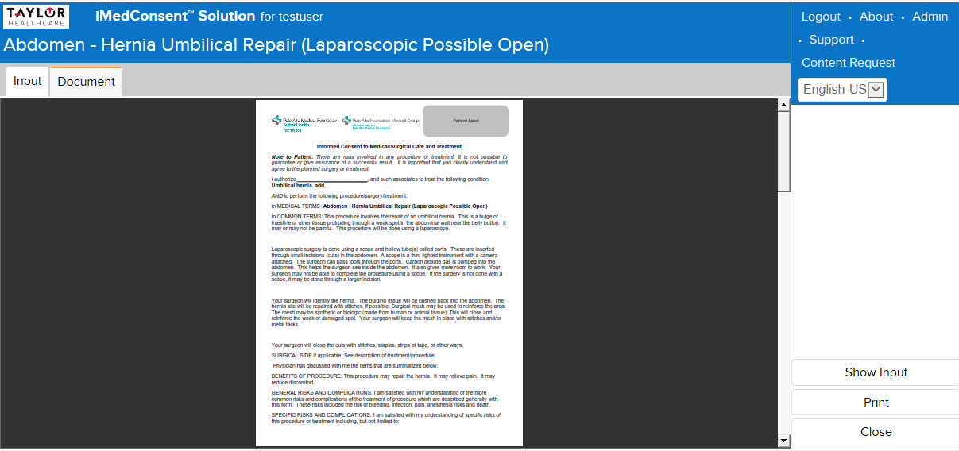
Printing
After completing the Input Tab, click on the Document Tab. This is where you are have the ability to print the document.

Slide 29
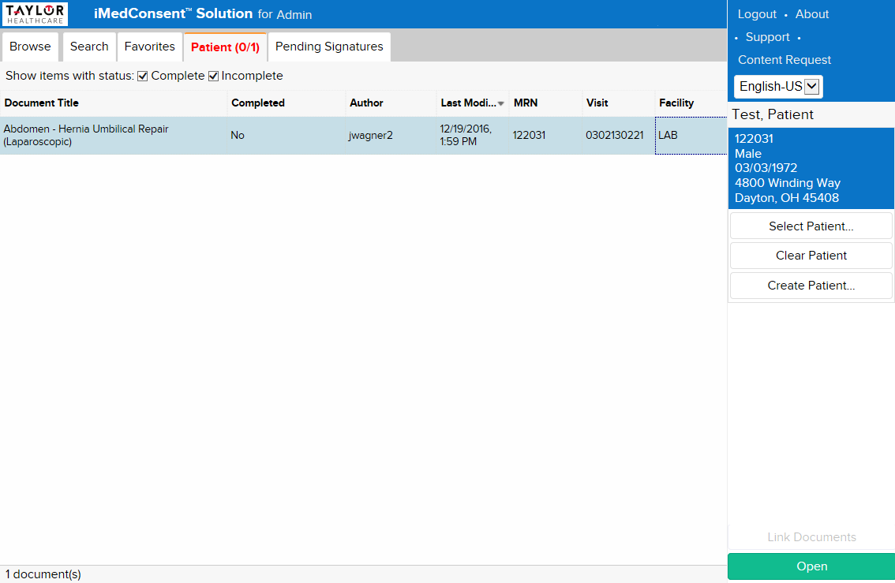
Viewing Consents
A consent is considered “complete” when all required signatures are captured.
The Patient tab displays all consents for the selected patient, both complete and incomplete. (Aged documents may be purged based on your facility configuration.)
Double-click a document to view a completed consent (or to continue working on an incomplete consent).

Slide 30
Summary
You now have an understanding of the iMedConsent application, including:
  How to Access iMedConsent
  Navigation
  Favorites
  Starting the Consent
  Working with Customizations
  How to Complete a Consent

